Slide 1
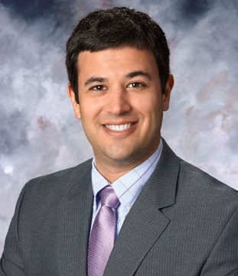
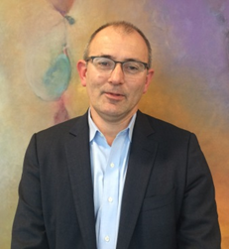
LECTURE SERIES
Biocatalysis At Merck
Matt Truppo, Ph.D.
Executive Director,
Merck & Co., Inc
Best Chemistry And World Class Supply
Ian Davies, Ph.D.
Department of Process Research & Development, Merck & Co., Inc.
December 6th, 3PM Location room 1315
www.nsf-cchf.com

