Slide 1
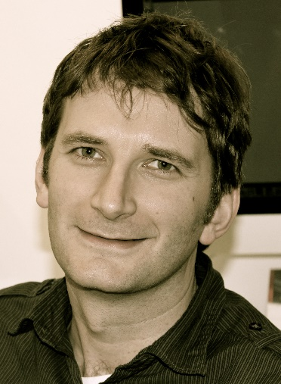
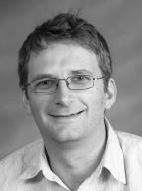
University of Wisconsin-Madison
AbbVie Symposium
Professor Matthew Gaunt
Department of Chemistry
University of Cambridge
Thursday, March 19, 2015
UW–Madison, Chemistry
Room 1315
3:00 p.m.
AbbVie Organic Synthesis Student Award Lecture
James Checco, Gellman Group
“Targeting Diverse Protein-Protein Interaction Interfaces with α/β-peptide Foldamers”
AbbVie Scientific Lecture
Dr. Eric Voight
“Organic Synthesis at the Interface Between Process and Medicinal Chemistry”
Break – refreshments served
AbbVie Organic Chemistry Lecture
Professor Matthew Gaunt
“Palladium Catalyzed C-H Activation of Aliphatic Amines”
3:30 p.m
4:00 p.m.
4:15 p.m.

