Slide 1
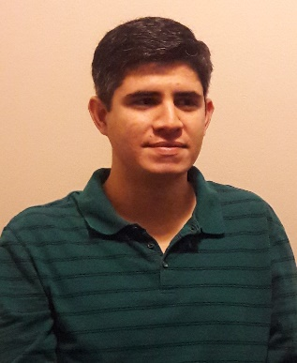
SPECIAL SEMINAR
Monday, December 12, 2016
3:30pm - Chemistry #1315
Dr. Carlos Jiménez-Hoyos
California Institute of Technology
Practical Quantum Chemistry Methods for Large Systems
with Strong Correlations
While quantum chemistry has been able to achieve tremendous accuracy for small systems, two important challenges remain partially unmet: a) an accurate quantum-mechanical treatment of very large systems, and b) dealing with systems where electron-electron interactions are strong. In this talk, I will discuss some of my earlier research in practical methods for strong correlation based on symmetry-projected and cluster-based configurations. I will then describe how the density matrix embedding theory (DMET) has recently allowed us to reach a high-accuracy quantum chemical solution for a formally infinite hydrogen chain. Some ideas for tackling the combined problem (ie, very large systems with strong electron correlations) will be discussed.

