Slide 1
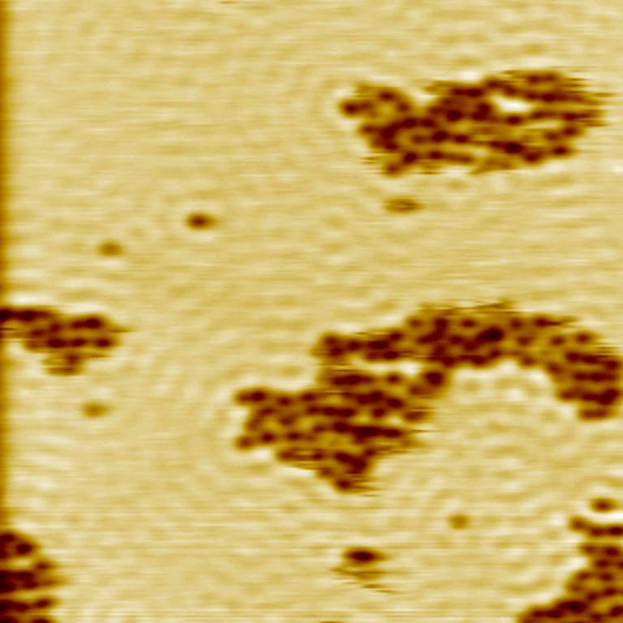
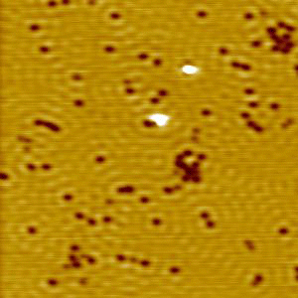
Quantum Tunneling Enabled H(D) Atom Diffusion at 5 K with STM
Hydrogen
Deuterium
Scale = (40 nm)²
Fast motion
Slow motion
Sykes Group, Tufts University (October 2012)
Explanation on following slide.
Jewell et al., ACS Nano ASAP DOI: 10.1021/nn3038463

Slide 2
EXPLANATION:
Scanning tunneling microscopy (STM) allows the structure of surfaces and adsorbed atoms/molecules to be studied with sub-nanometer resolution. Hydrogen atoms on a copper surface appear as small dark spots that move around rapidly whereas deuterium atoms move slowly. This illustrates that hydrogen atom diffusion on surfaces at very low temperatures occurs not by thermally activated hopping but via Quantum Tunneling. This weakly bound hydrogen can perform efficient hydrogenation reactions.

